Slide 1
Machine Learning Premalatha T

Slide 2

WHO AM I?
LinkedIn: https://www.linkedin.com/in/latha-t-k-b21018128/
Data Science ,AIML
Data Analysis ,SQL,Pyspark
Data Visualization ,PowerBI,Tableau
Natural Language Processing (NLP)
Computer Vision
Generative AI,Prompt Engineering
BigData and Data Engineering

Slide 3
Agenda
What is ML,DL and AI
Steps in a ML Project
ML Techniques and Tools

Slide 4
Data?
Information and Noise(Insignificant information)
ML ,DS,AI-> Extract information(Exclude noise)

Slide 5
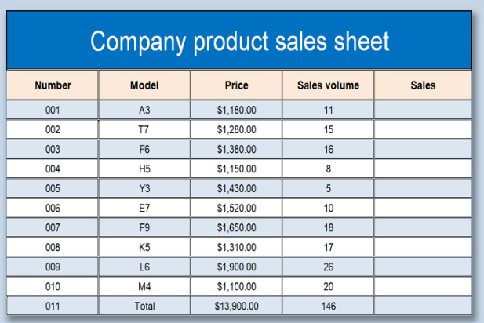
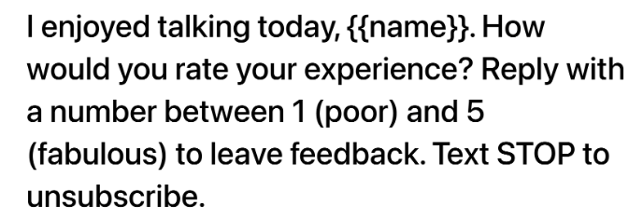

Slide 6
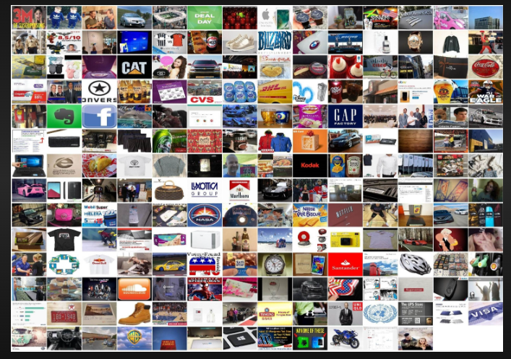
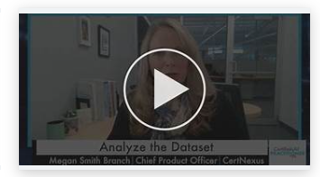
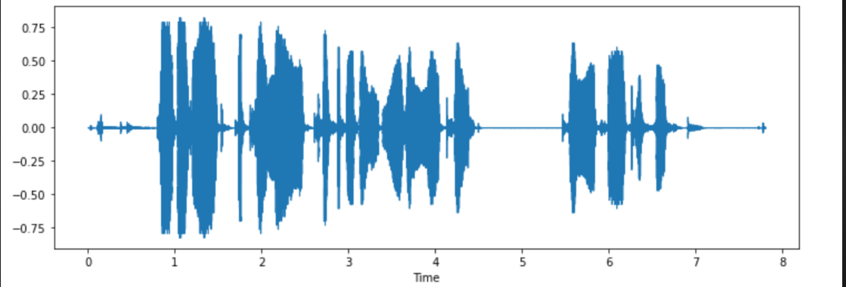

Slide 7




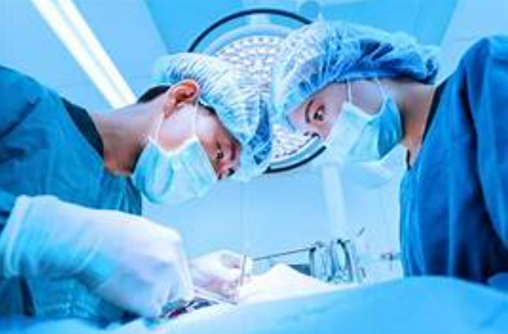

Slide 8
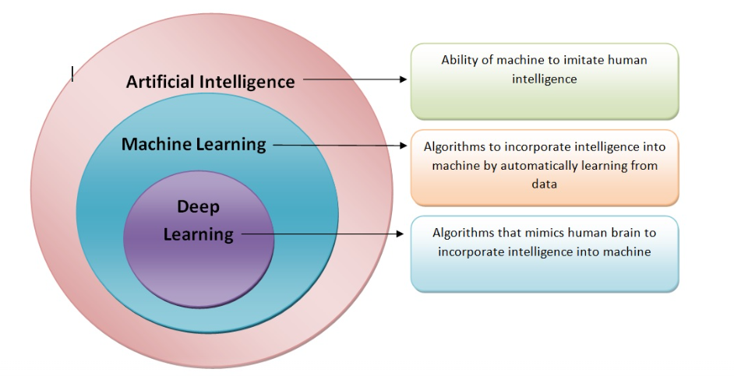

Slide 9
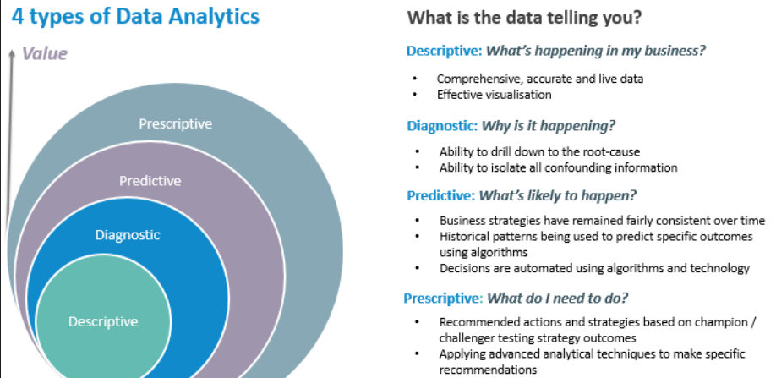

Slide 10
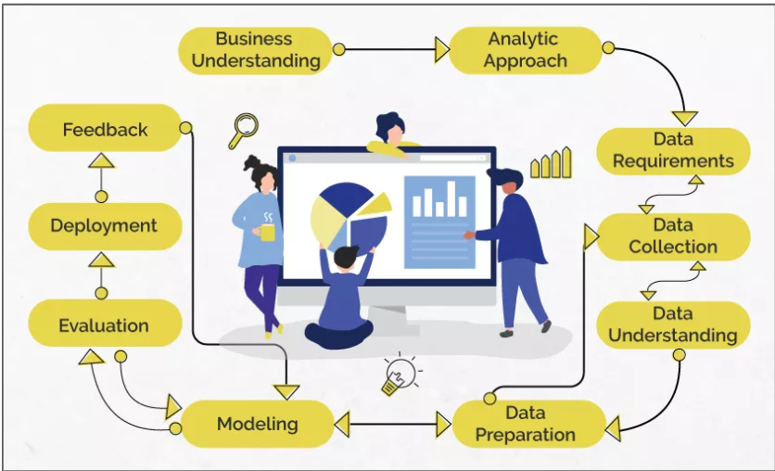
Data Science/Machine Learning

Slide 11
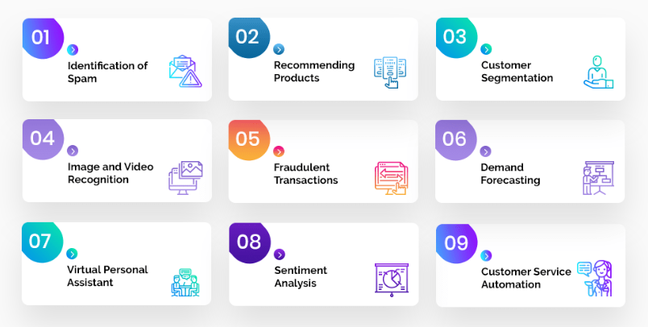
Problem Statement

Slide 12
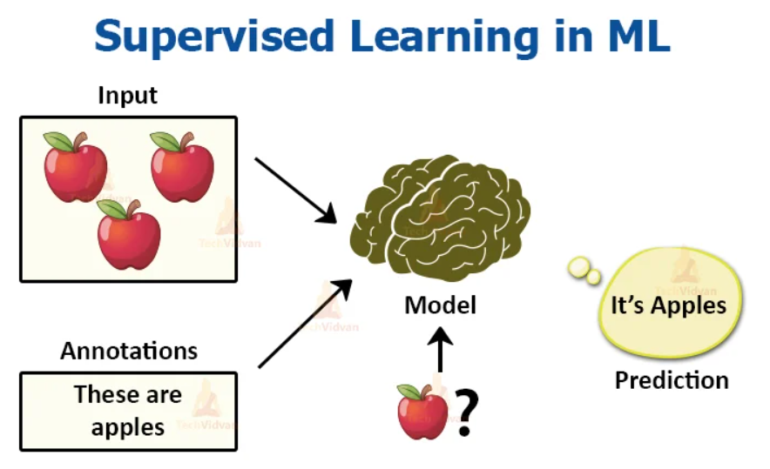
Analytic Approach

Slide 13
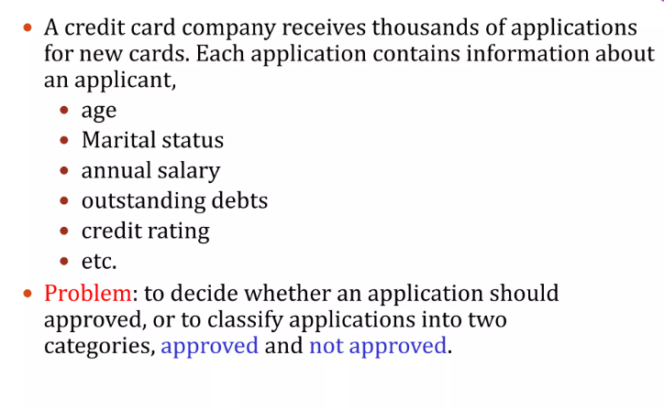
Supervised Learning

Slide 14
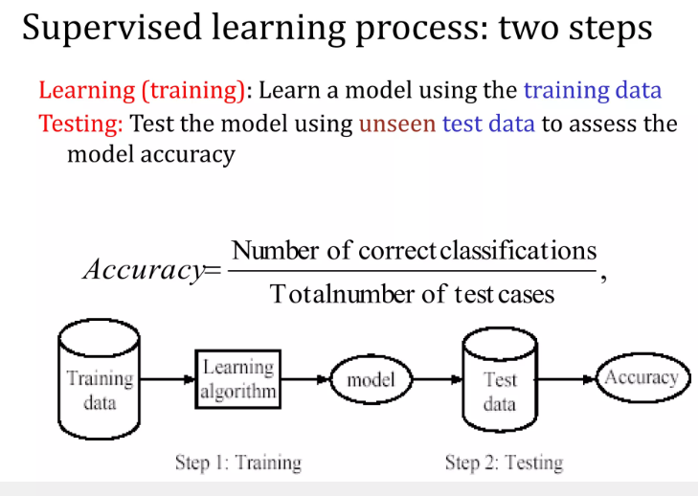

Slide 15
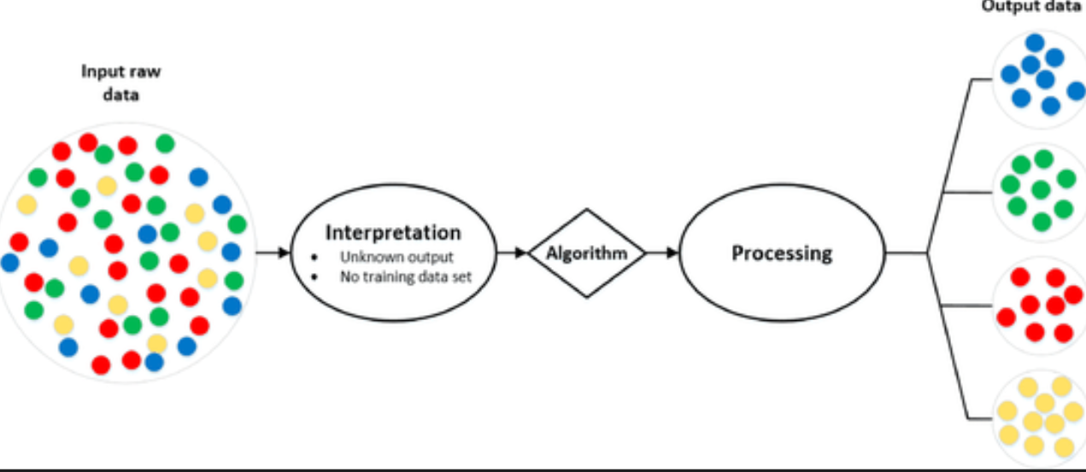
Analytic Approach

Slide 16
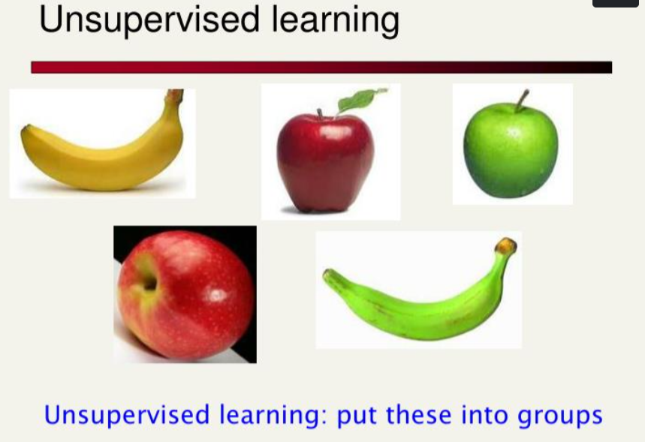

Slide 17
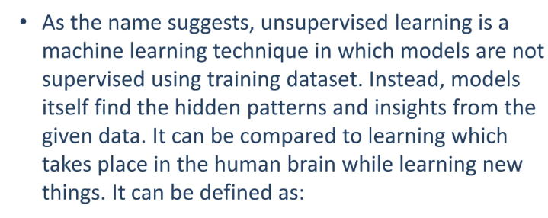

Slide 18
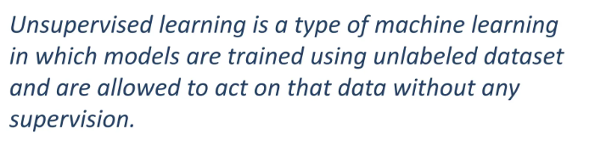

Slide 19
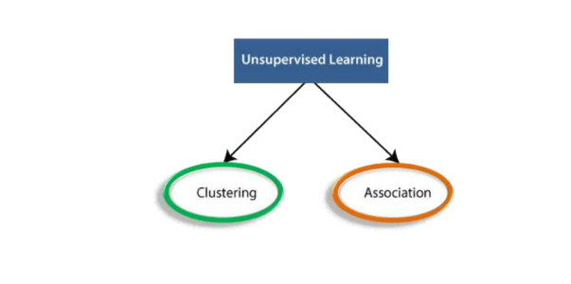

Slide 20
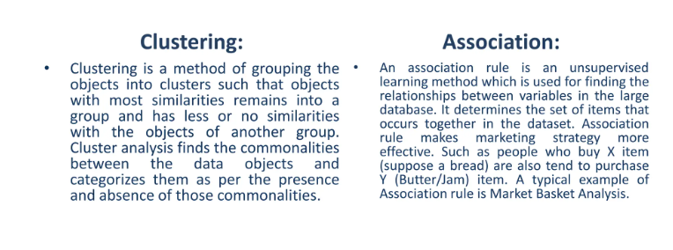

Slide 21
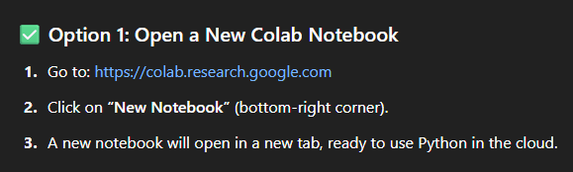

Slide 22
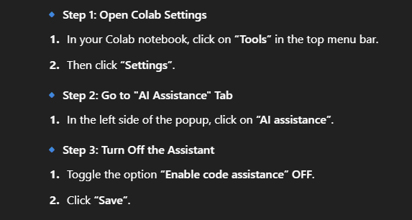

Slide 23
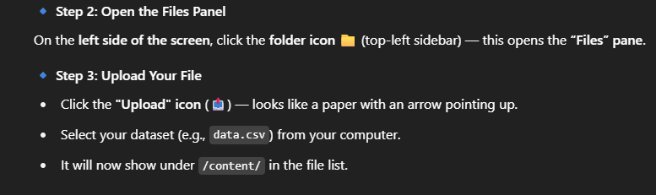

Slide 24
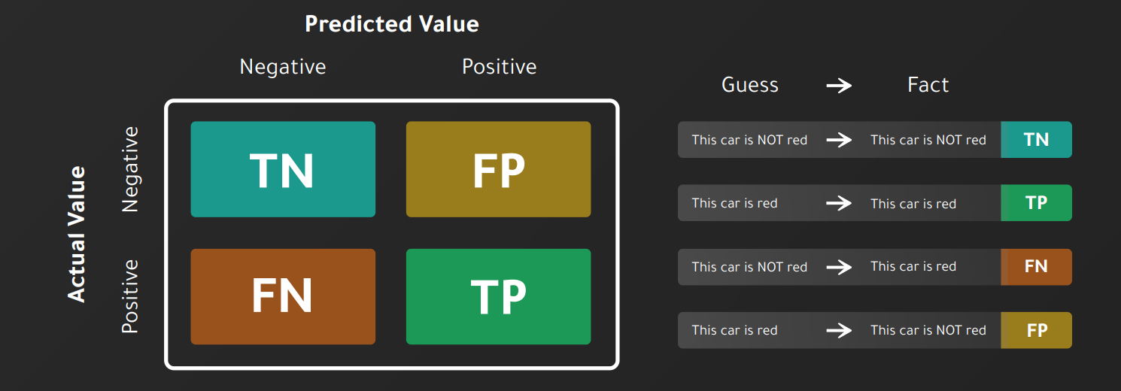

Slide 25
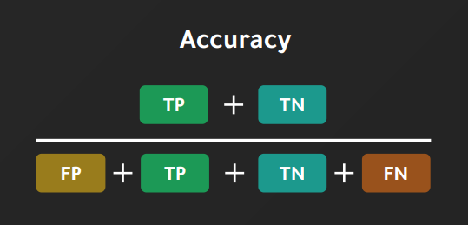

Slide 26
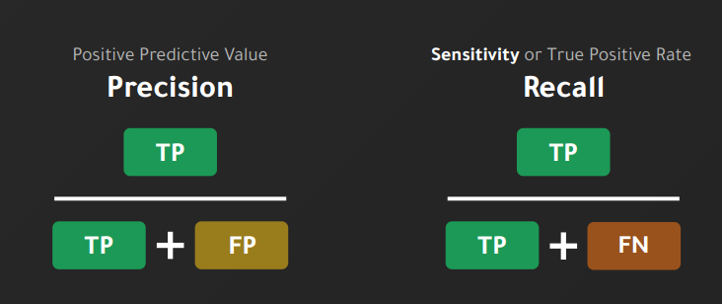

Slide 27
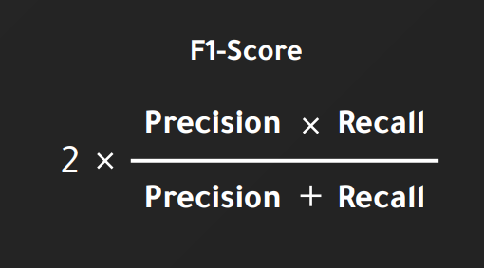

Slide 28
Questions ????

